Slide 1

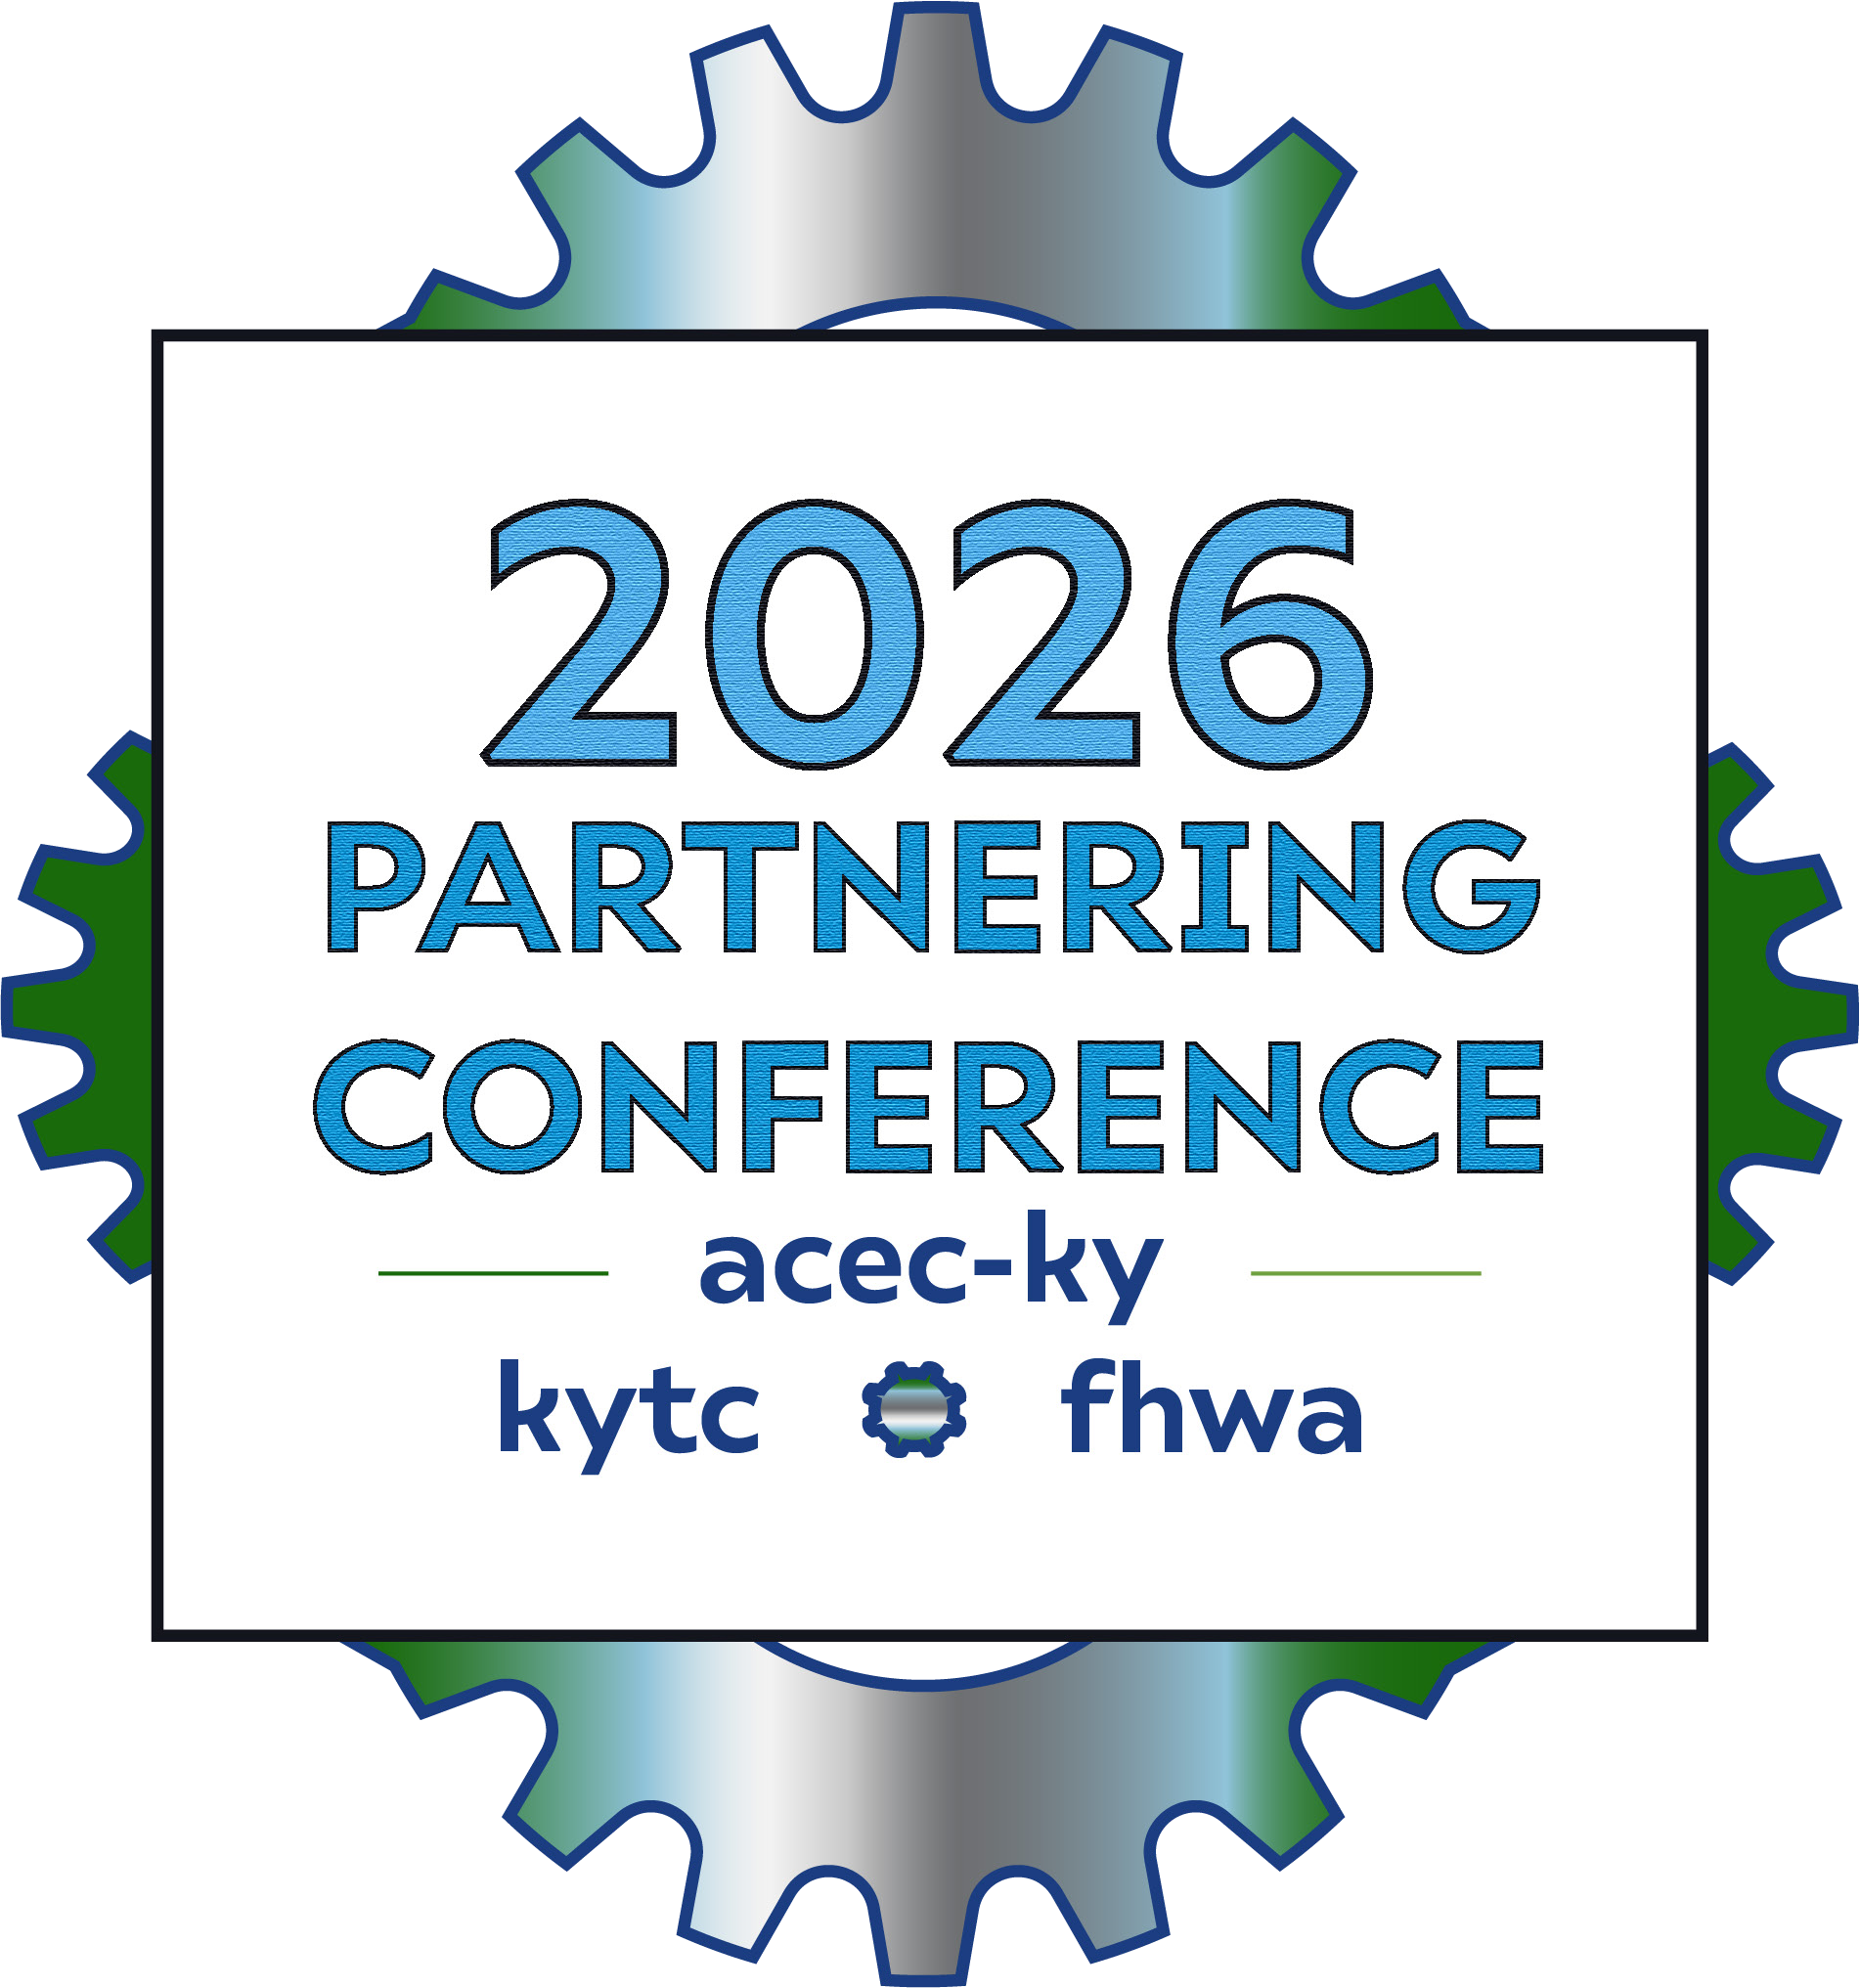
“You Can’t Sit With Us!”
How Planning and Maintenance are Partnering
September 10, 2026 | Lexington, Kentucky

Slide 2


Agenda
Background
Dam Study
Resiliency Plan
D10 & D12 Rockfall Studies
Roadside Barrier Study
Geography Lesson
Border Bridge Study
Bridge Posting Study
Exchange Tearful Goodbyes

Slide 3

AI disclaimer: They gave me access to Copilot last week so I’m testing things out. Some slide content was developed by Copilot and edited by me.
Some are my own creations.
Let me know which is better.

Slide 4
Background

Slide 5
The Entire Presentation Hinges on This Joke

Slide 6
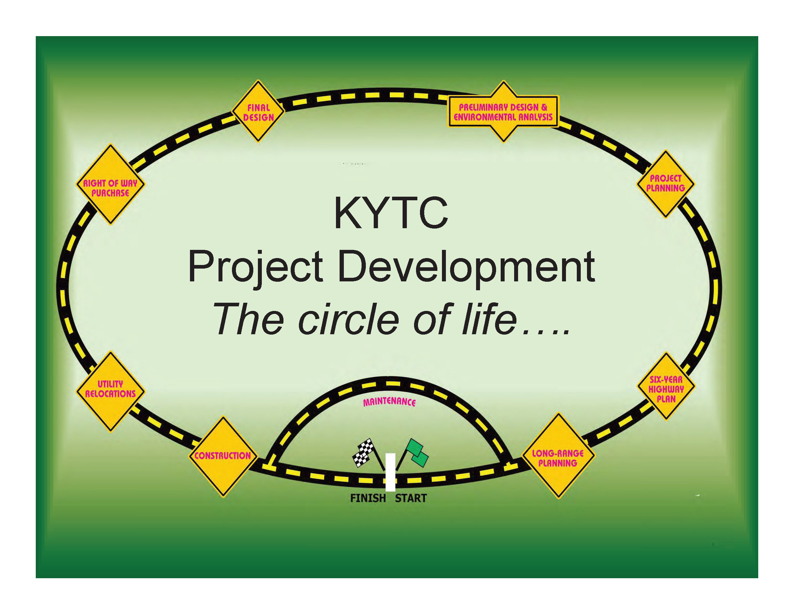



Slide 7


Slide 8
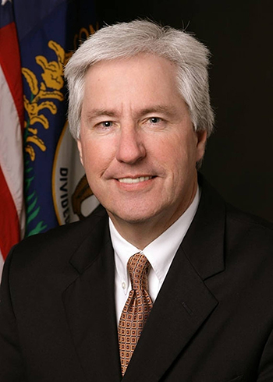
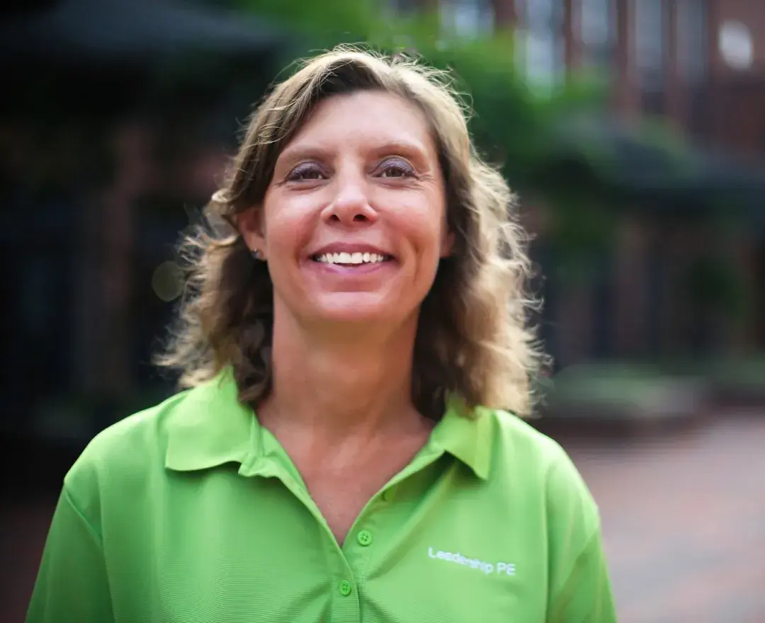


Slide 9

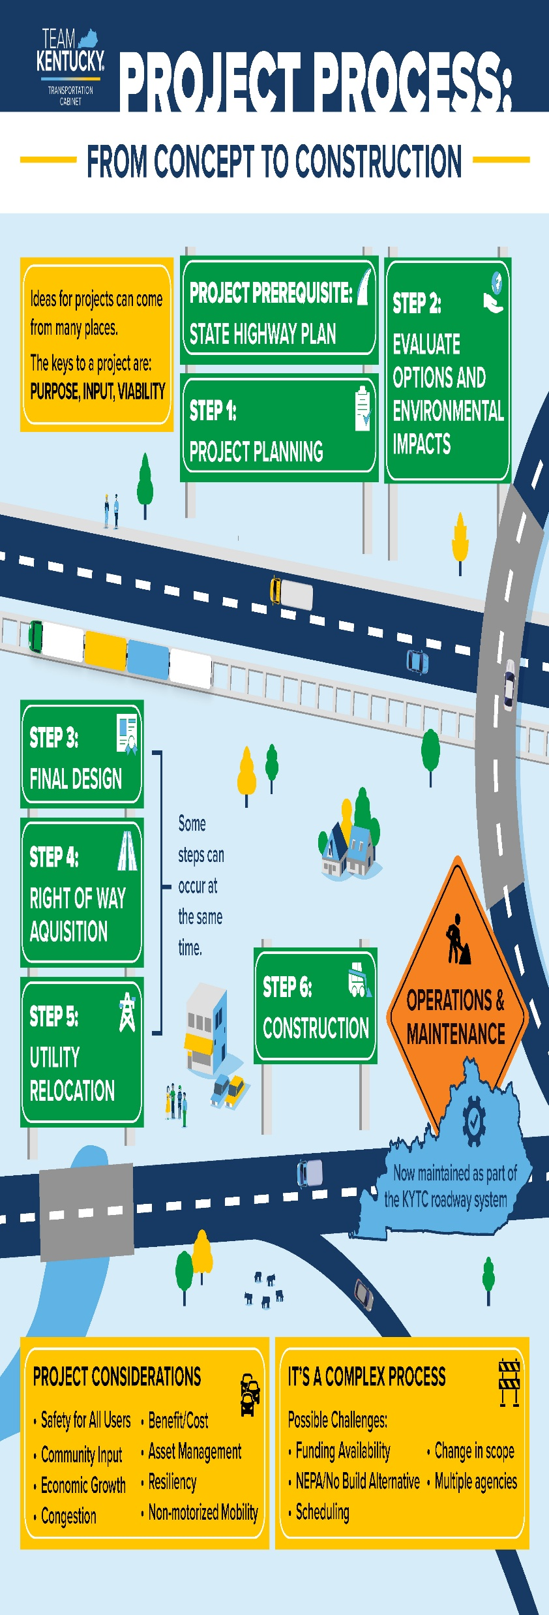


Slide 10
Dam Assessment Study

Slide 11
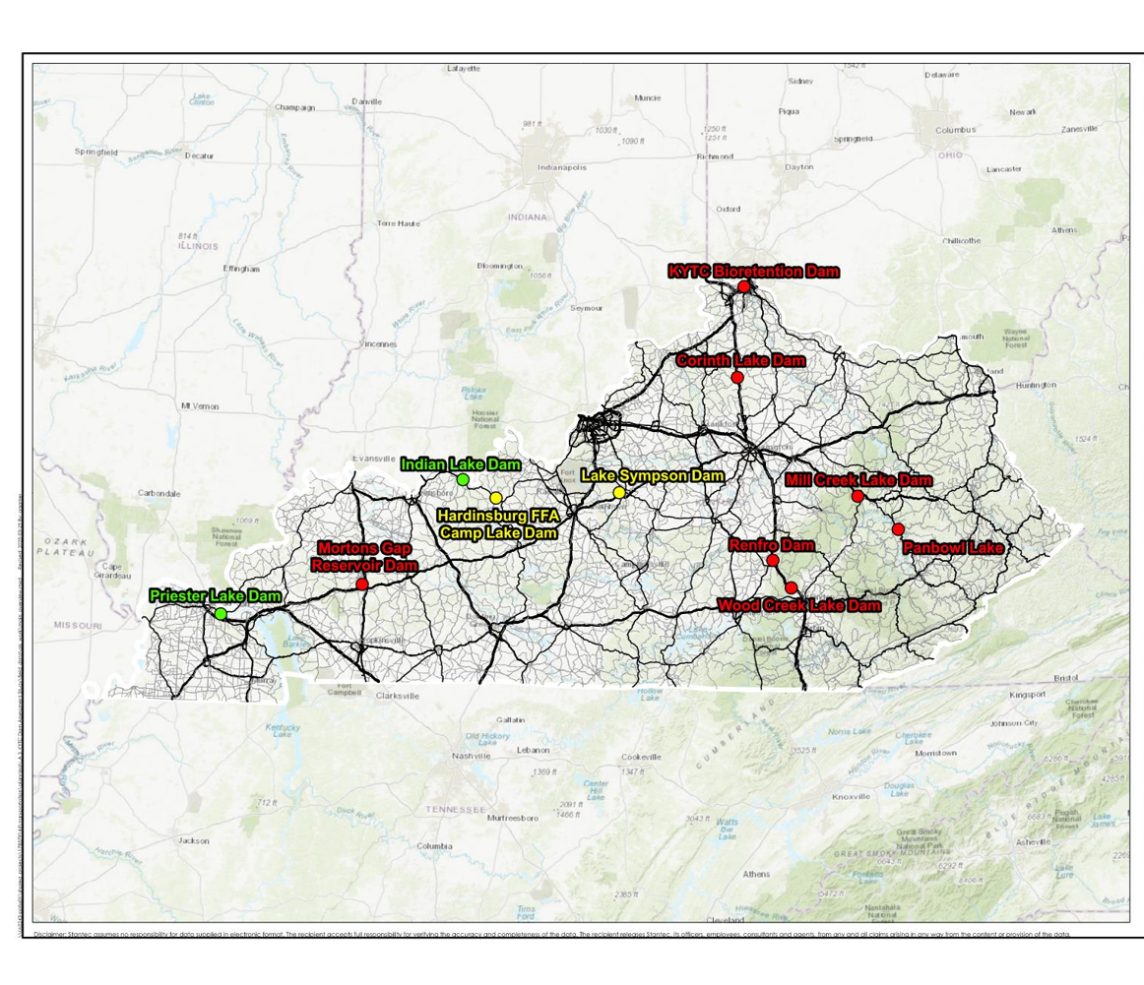
KYTC Owned Dams
KYTC owns 11 dams
2 (Panbowl and Sympson) excluded from study due to current construction projects
Notes:
Of the 39, KYTC owns 11 dams in 11 different counties and spread out over 7 Districts. Average age 55 years, with 6 out of 7 being around 62 years old.

Slide 12
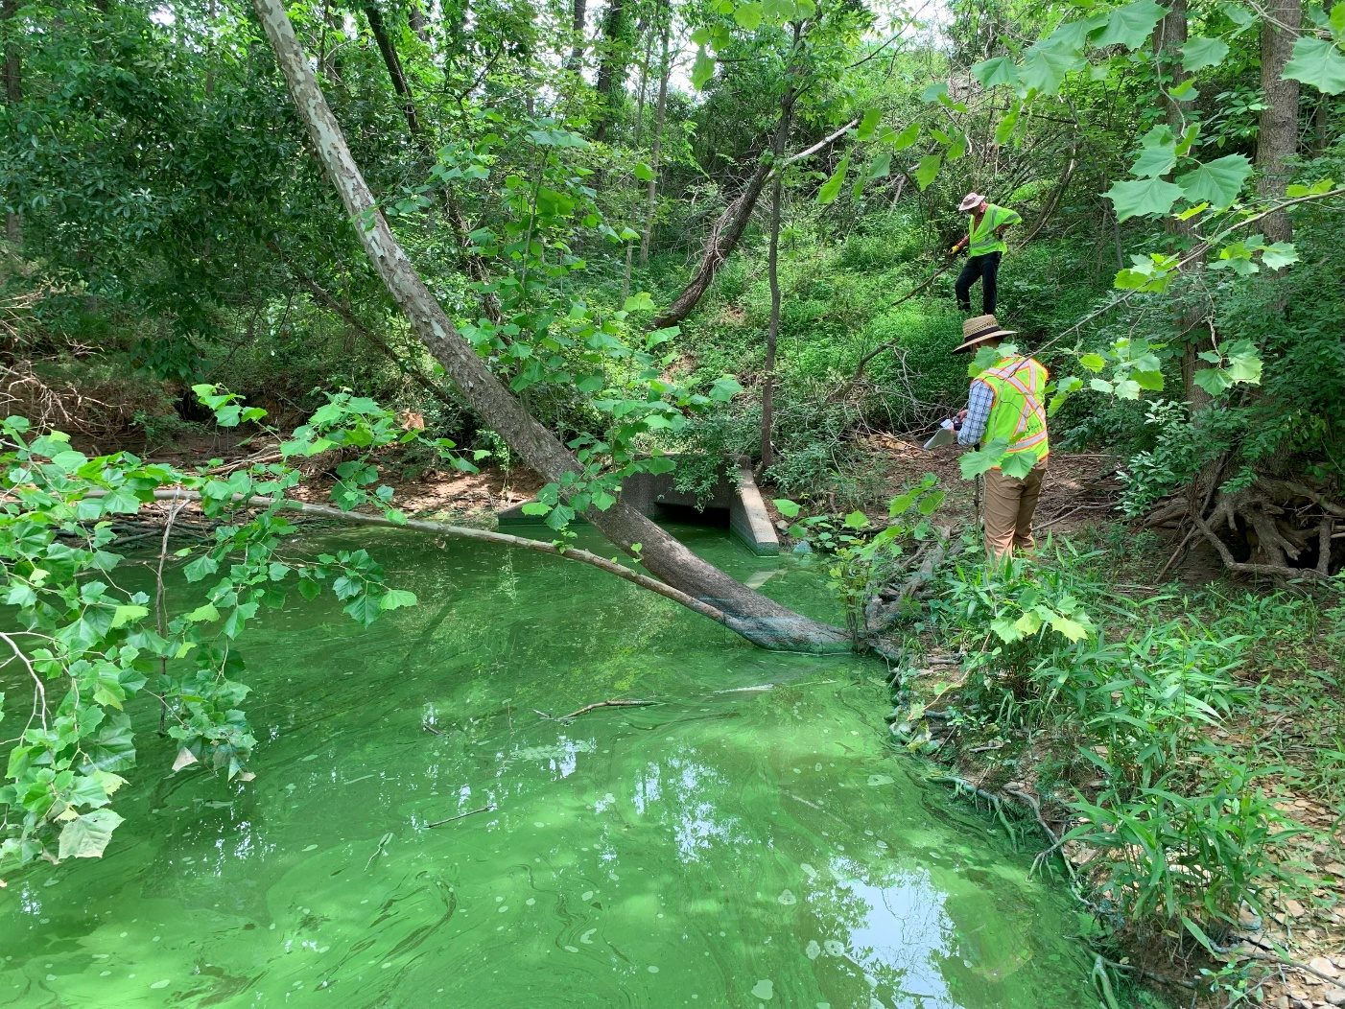
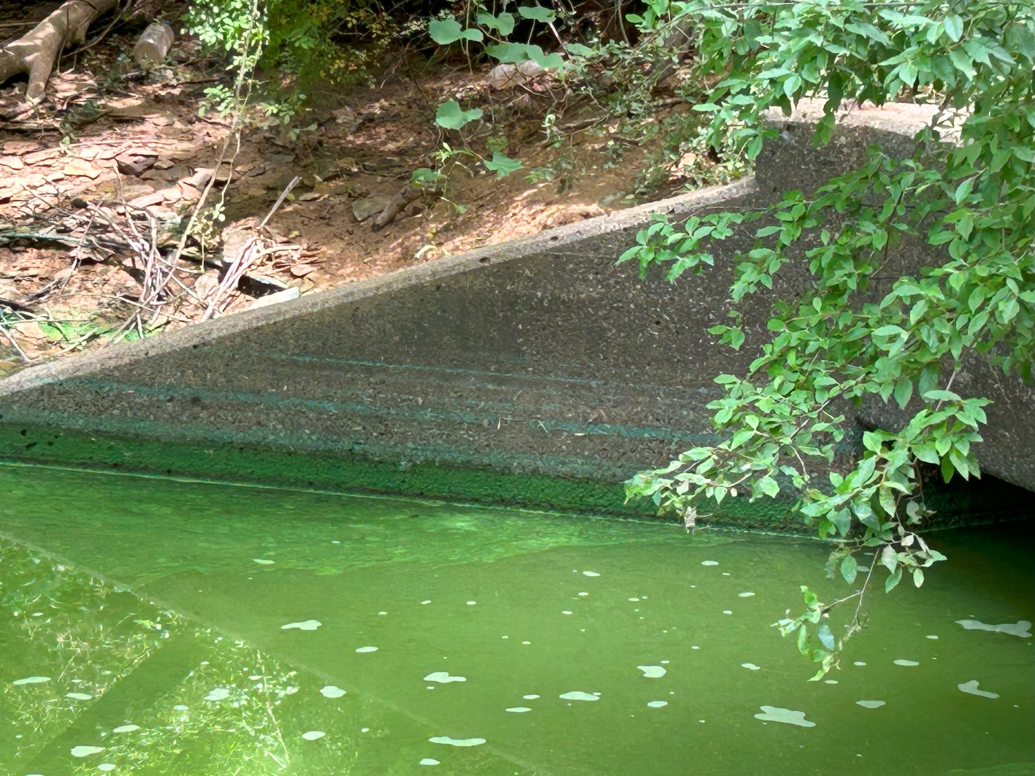
Observations:
Hardinsburg: Tailwater
Hardinsburg: Historical Water Levels
Notes:
Some of the nastiest tailwater I’ve ever seen – spillway outlet at Hardinsburg; but it did allow us to better observe the highwater marks, which as you can see rise above the height of the oultet. Oh we were not told we would be in the “water moccasin/cottonmouth capital of Western KY” at this dam!!!

Slide 13

Potential Failure Mode Analysis (PFMA)
Screening Process
Dam Risk is probability of adverse consequences from dam failure =
Prob. Failure x Consequences (basic terms)
Dam Risk (F_{p})
Consequences (lives, econ., env.)

Slide 14
Recommendations at Renfro Dam
Code | Recommendation | Type | Life Loss Risk | Economic & Transportation Risk | Regulatory Compliance | Cost Range | Planning Horizon | Priority
REPAIR TRASH BOOM | Repair the floating boom on the upstream side of the morning glory spillway entrance. | O&M | 9 | 12 | Yes | <10K | Short Term | 1
VEGETATION REMOVAL | Remove trees in the area surrounding the morning glory spillway entrance. | O&M | 9 | 12 | Yes | <10K | Short Term | 2
WARNING SIGNS | Install multiple warning signs on riser and spillway structures (DANGER - KEEP BACK). | O&M | 0 | 0 | No | <10K | Short Term | 3
CRASH BARRIER STUDY | Evaluate the median crash barrier for performance as a temporary floodwall. [To be performed in conjunction with study of the under pass.] | Investigation | 9 | 12 | Yes | 10K-100K | Short Term | 4
AUXILIARY HYDRAULIC STUDY | Study the performance of the Lake Linville Road underpass as an auxiliary spillway (hydraulics, flow path, erodibility). [To be performed in conjunction with study of the barrier wall.] | Investigation | 3 | 3 | Yes | 10K-100K | Short Term | 5
REPAIR LLD | Implement repairs identified in the 2024 low level inspection, replace the slide gate if necessary. | O&M | 0 | 6 | Yes | 100K-1M | Intermediate | 6
MODIFY ROAD | Modify adjacent road underpass to perform as an auxiliary spillway and/or modify the median crash barrier. | Capital | 3 | 3 | Yes | 1M-10M | Long Term | 7

Slide 15
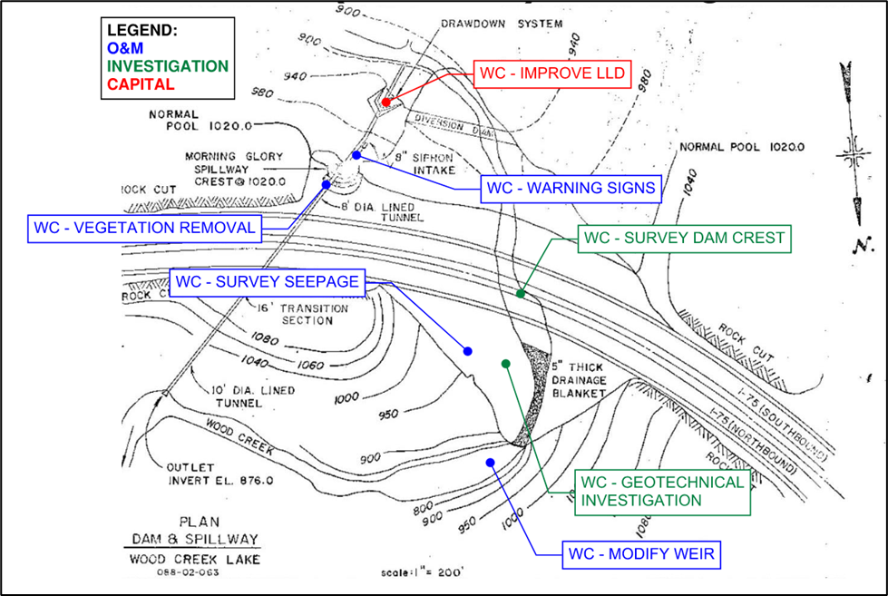
Example:
Improvement Recommendations at Wood Creek Lake Dam

Slide 16
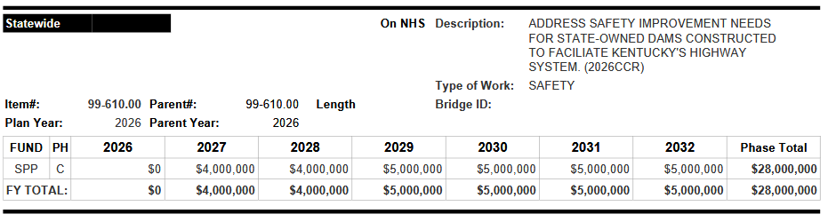
Outcome:
Prioritized List of Improvements, address KDOW concerns

Slide 17
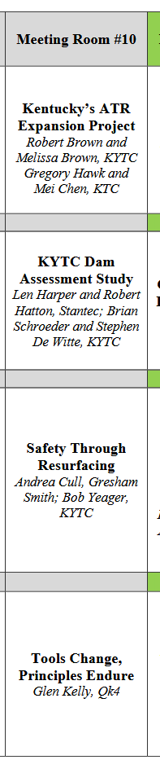

Dam QR Code

Slide 18
Resiliency Plan

Slide 19
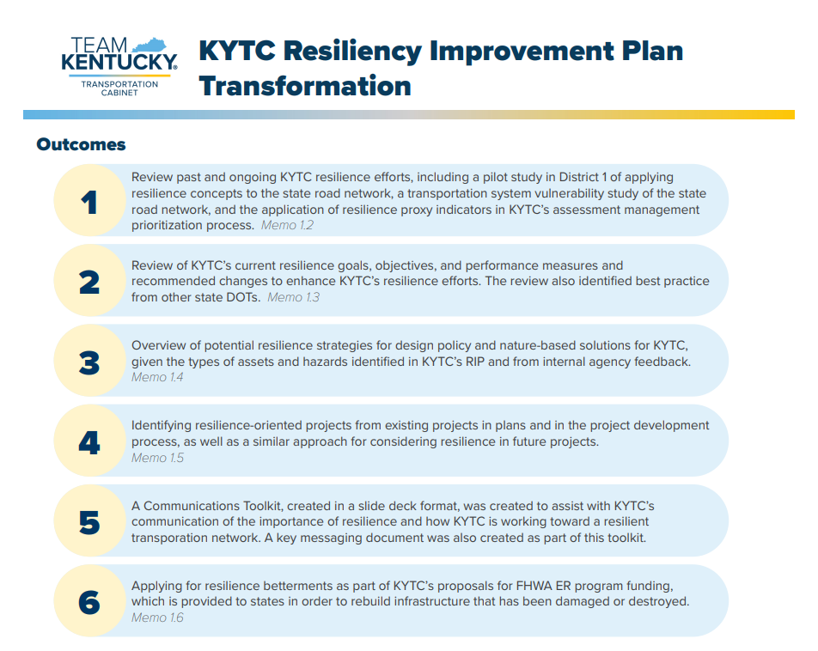

Slide 20
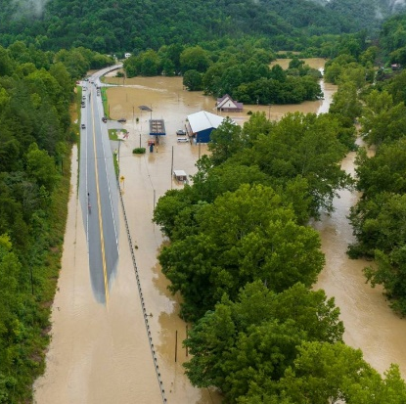
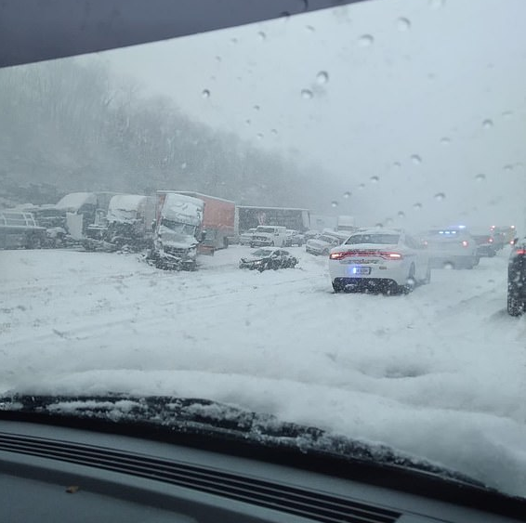
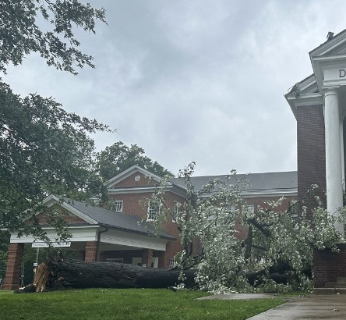
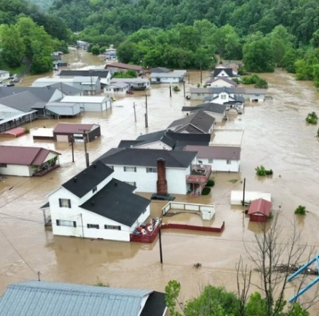
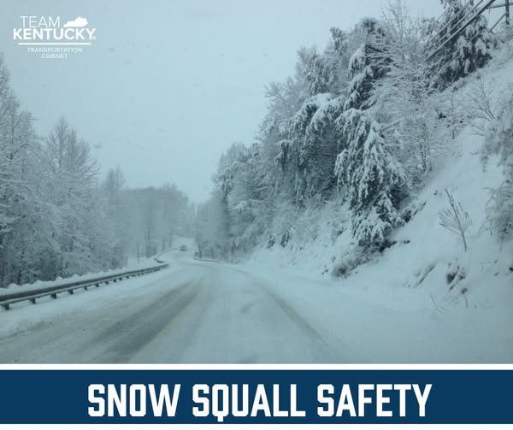
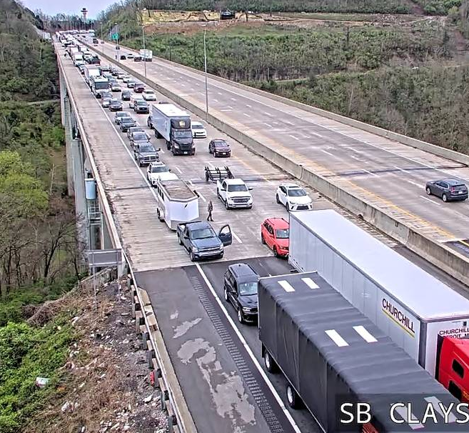
Key Present-Day Hazards
Flooding
Severe Thunderstorms
Severe
Winter Storms
Louisville, Kentucky – 2024 severe thunderstorm impacts
Southeastern Kentucky - 2022 floods
Lexington, KY 2022 winter storm pileup
Traffic impacts in southbound lanes of I-75 at Clays Ferry Bridge due to interstate closures because of storm debris and downed wires
Notes:
Photo Sources:
Southeastern Kentucky – 2022 Floods (https://www.naco.org/articles/kentucky-counties-dig-out-after-devastating-floods & https://spectrumnews1.com/ky/louisville/news/2024/08/15/kentucky-flood-recovery-august-2024-)
A fallen tree outside of Douglass Boulevard Christian Church in Louisville after severe storms hit the area May 26, 2024. (Spectrum News 1/Jordan Grantz) - https://spectrumnews1.com/ky/louisville/news/2024/05/26/kentucky-severe-weather-storms
Severe Thunderstorms Traffic Impacts: https://www.kentucky.com/news/weather-news/article287308805.html
Social Media Post: https://www.facebook.com/kytc120

Slide 21
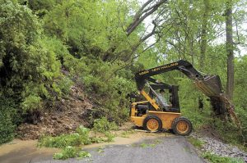
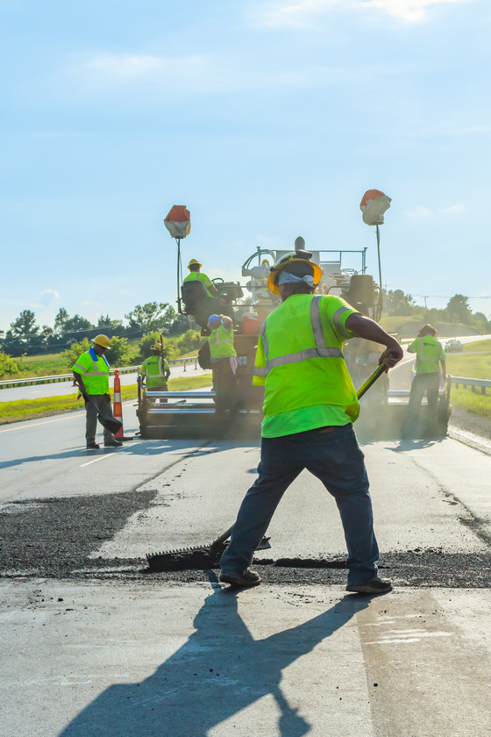
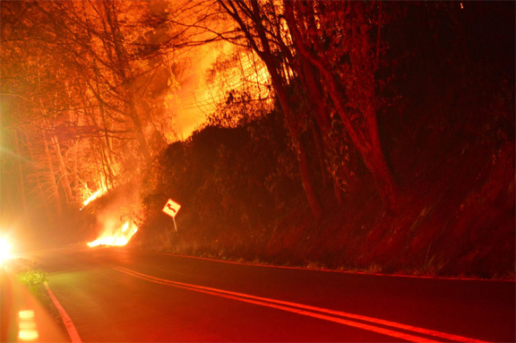
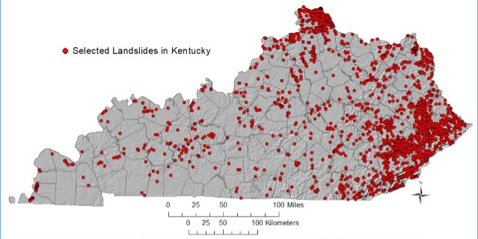
Key Present-Day Hazards (cont.)
Extreme Temperatures
Wildfires
Landslides
Landslide in Four Mile
KYTC Road Crew in D1
Wildfire crossing a road from Kentucky Emergency Management
Locations of selected landslide occurrences from the Kentucky Geological Survey landslide inventory.
Notes:
Photo Sources:
Wildfire across a road – Kentucky Emergency Management, https://kyem.ky.gov/KentuckyWildfires/Pages/default.aspx
Landslide - KYTC

Slide 22
Future Hazards and Impacts on Transportation
More Intense Precipitation
Higher Flood Flows
Increased Wildfire Chances
Increased Intensity of Snow & Ice Events
Extreme Temperatures
Increased Landslide Potential
Increased Drought Potential
Notes:
Most Significant Impacts Anticipated
Increased road and rail closures in affected areas.
Compromised pavement integrity
Deformation of rail lines
Thermal expansion of bridge joints
Damage to airline infrastructure/Canceled flights
Decrease in river transportation
Decrease in electricity production from hydroelectric plants
Higher incidents of flooding for communities located on or near waterways.
Poorer air quality

Slide 23
Collective Hazard Impacts
Compromised system reliability, public safety and increased costs on taxpayers.
Impacts on System Users
More difficult driving conditions
Less comfort for transit users
Decreased roadway safety
Increased rerouting and delays
Economic impacts from reduced access to places and disruptions to goods movements
Impacts on KYTC
More frequent and costly maintenance and repairs
More challenging operations environment
Increase in unsafe conditions for staff

Slide 24
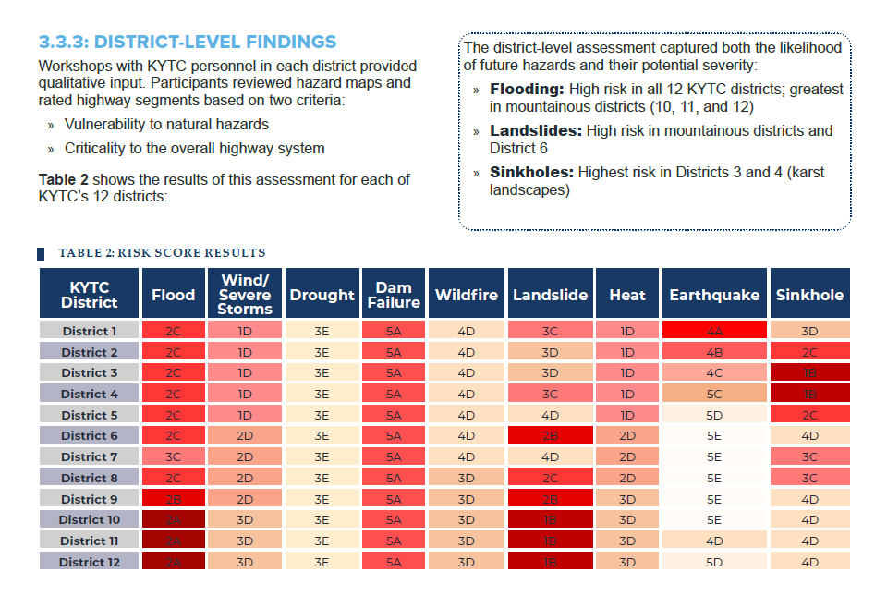

Slide 25
D10 & D12 Rockfall Mitigation Studies
(some content by Copilot)

Slide 26
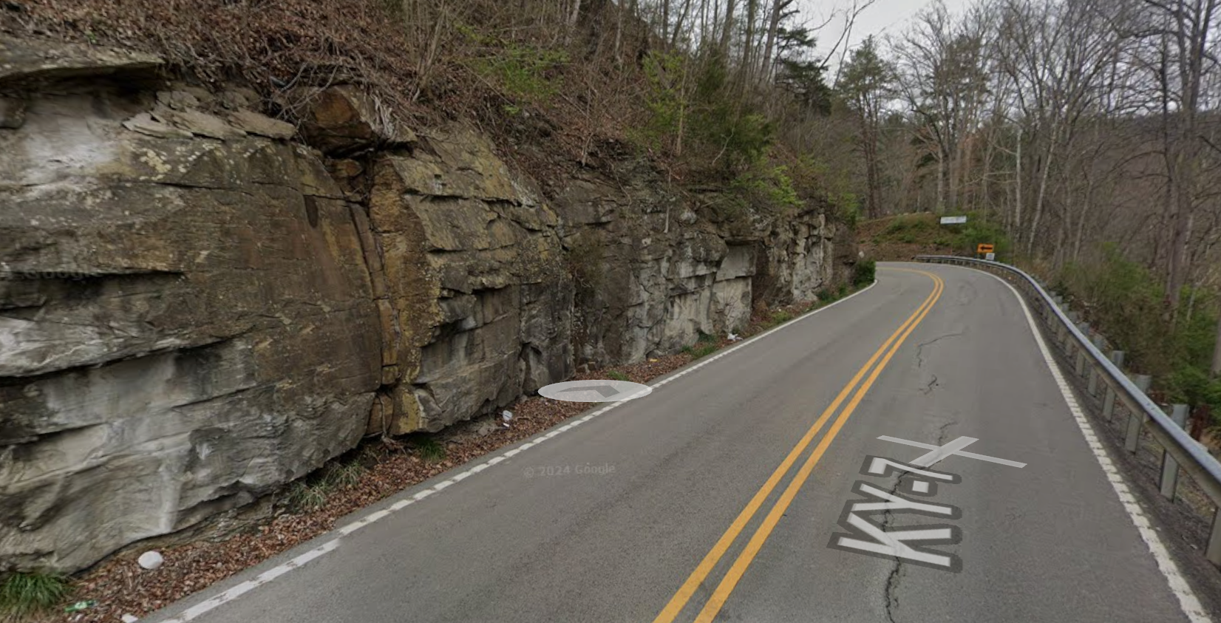
Rockfalls and roadslide hazards cause closures, detours, and safety risks across our network.
2,947 records → 1,112 unique sites → ~300 desktop‑ranked → 50 field checks → Top 15 for action.
Ranking blends engineering risk with network importance (SHIFT) so we fix the most impactful places first.

Slide 27
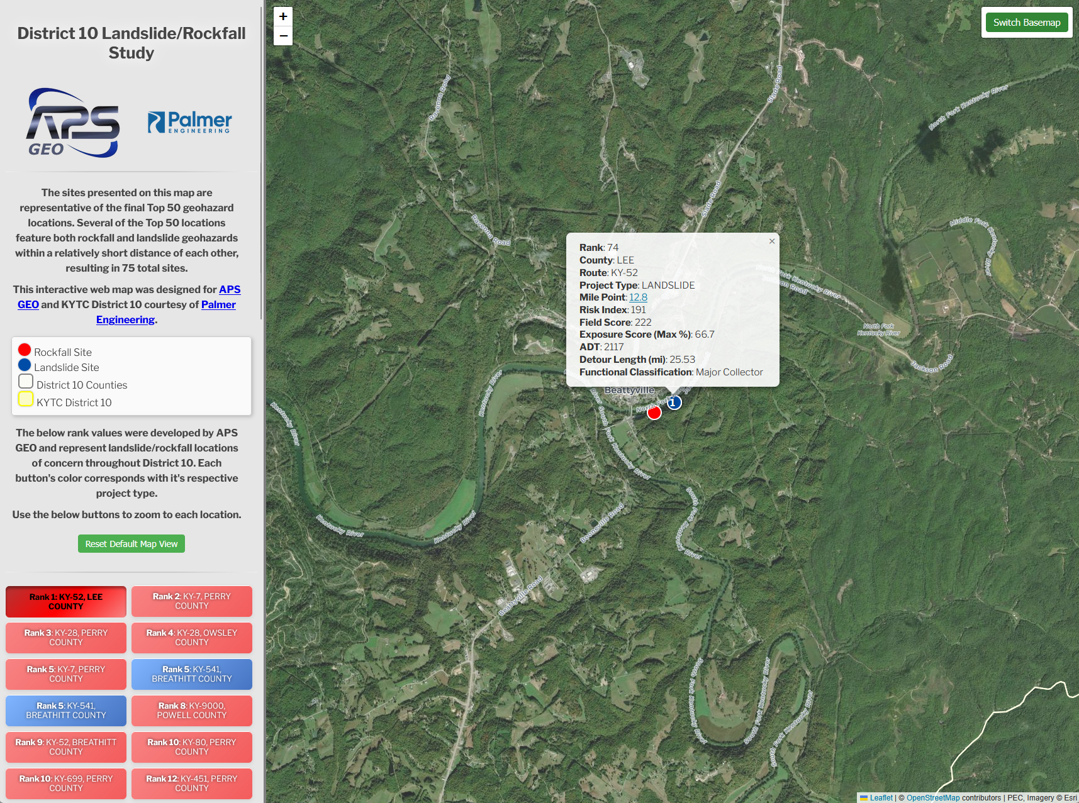

Slide 28
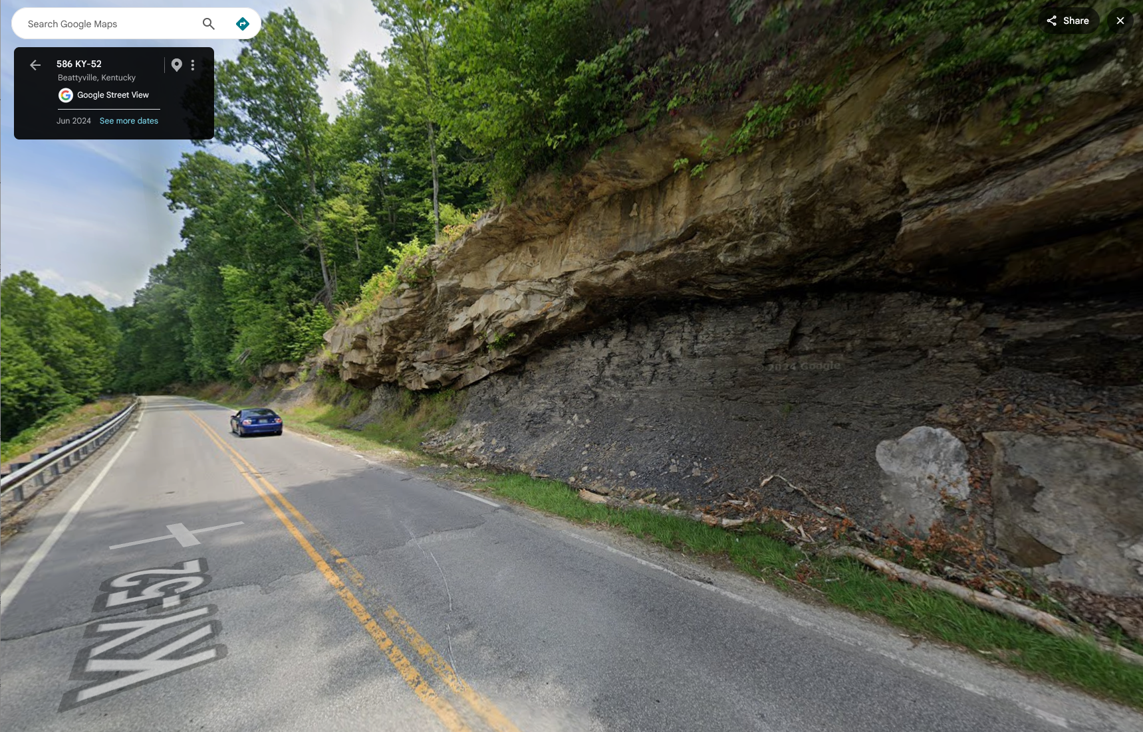

Slide 29
Outcome: a clear, defendable priority list to program projects and pursue funding.
Short‑term (0–2 yrs): targeted clean‑ups and scaling; add fencing or mesh where it buys safety now.
Medium‑term (2–5 yrs): program projects (walls, mesh, catchment improvements) in the Highway Plan.
Long‑term (5+ yrs): complex sites needing design & permits — package and bundle to cut mobilization costs.
Value for money: several priority sites show BCR > 1.5 — good candidates for competitive funding.
Do the basics early: confirm permits (404/401, USFWS, Section 106) and bat tree‑clearing windows to avoid delays.

Slide 30


D10 Study QR Code
Interactive Map QR Code

Slide 31
Roadside Barrier Study
(some content by Copilot)

Slide 32
Pilot highlights — what we learned
Routes: KY‑8, KY‑11, KY‑36, KY‑190, US‑31E, US‑119.
Initial counts (assets): Guardrails 63; End Treatments 94; Transitions 7; Concrete Barriers 2; Crash Cushions 4; Continuations 24.
Fixing data issues: errant sessions, height/offset calcs, incomplete imagery.
Improvements: QC layer; parent‑child relationships; limited street‑view checks.

Slide 33
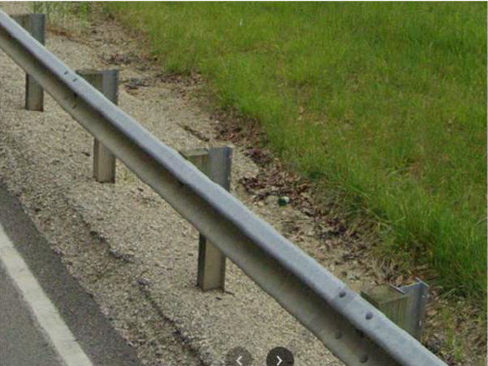
Why we’re doing this
• Today’s inventory is uneven and not centralized.
• Use KYTC LiDAR and imagery to locate/describe assets without putting crews in traffic.
• Find and plan replacements for older/pre‑NCHRP 350 hardware.

Slide 34
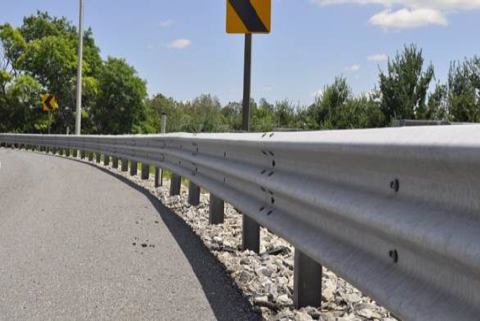
What we’re doing
• Build the ID guide + data dictionary; run a short urban + rural pilot.
• Extract from KYTC data; add attributes + condition; target 95% QA/QC.
• Trimble app for field updates; documentation, training; turnover to KYTC GIS/OMS.

Slide 35
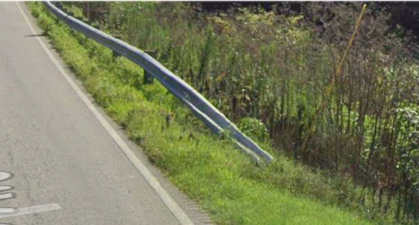
Partnering — Planning + Maintenance
• Align inspection criteria with Maintenance priorities.
• Use Priority 1/2 defects only (actionable).
• Add speed‑based qualifiers where needed (e.g., obstacles, curb offsets).
• Flag program decisions: Type 7 turndown ends, prong reflectors, post backfill.

Slide 36
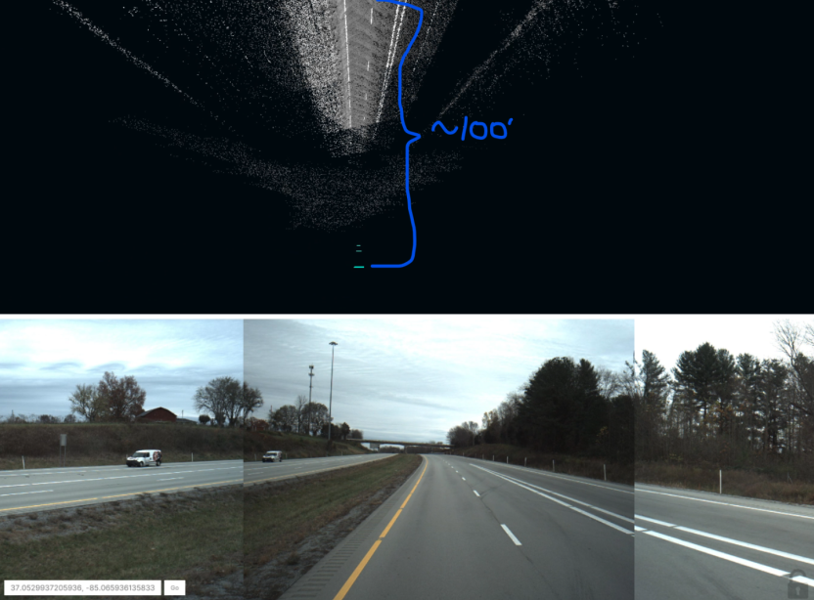
Pilot overview and initial findings
• Pilot routes: KY 8, KY 11, KY 36, KY 190, US 31E, US 119.
• Initial assets: Guardrails 63; End Treatments 94; Transitions 7; Concrete Barriers 2; Crash Cushions 4; Continuations 24.
• Data issues addressed: errant sessions; offset/height calc; incomplete imagery.

Slide 37
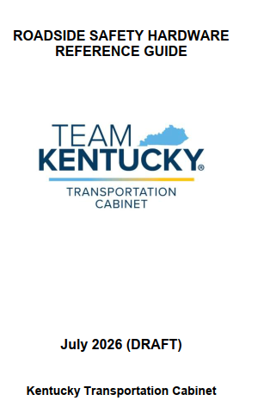
Reference Guide — Identification & Inspection
• KYTC‑tailored identification pages (guardrail, transitions, crash cushions, cable).
• Inspection tables focus on Priority 1/2 defects.
• Actionable attributes: curb/delineation, blockouts, struts, rubrails, side panels, continuation notes.

Slide 38
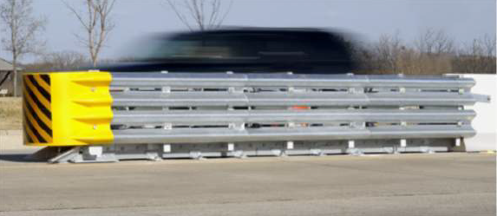
Expected outcomes
• Statewide inventory: ~70,000 features over ~16,000 centerline miles.
• Desktop condition + functional assessment; critical items reported via email + dashboard.
• Trimble app aligned to OMS database; decision trees; study documentation; integration to KYTC systems.

Slide 39
Geography Lesson

Slide 40
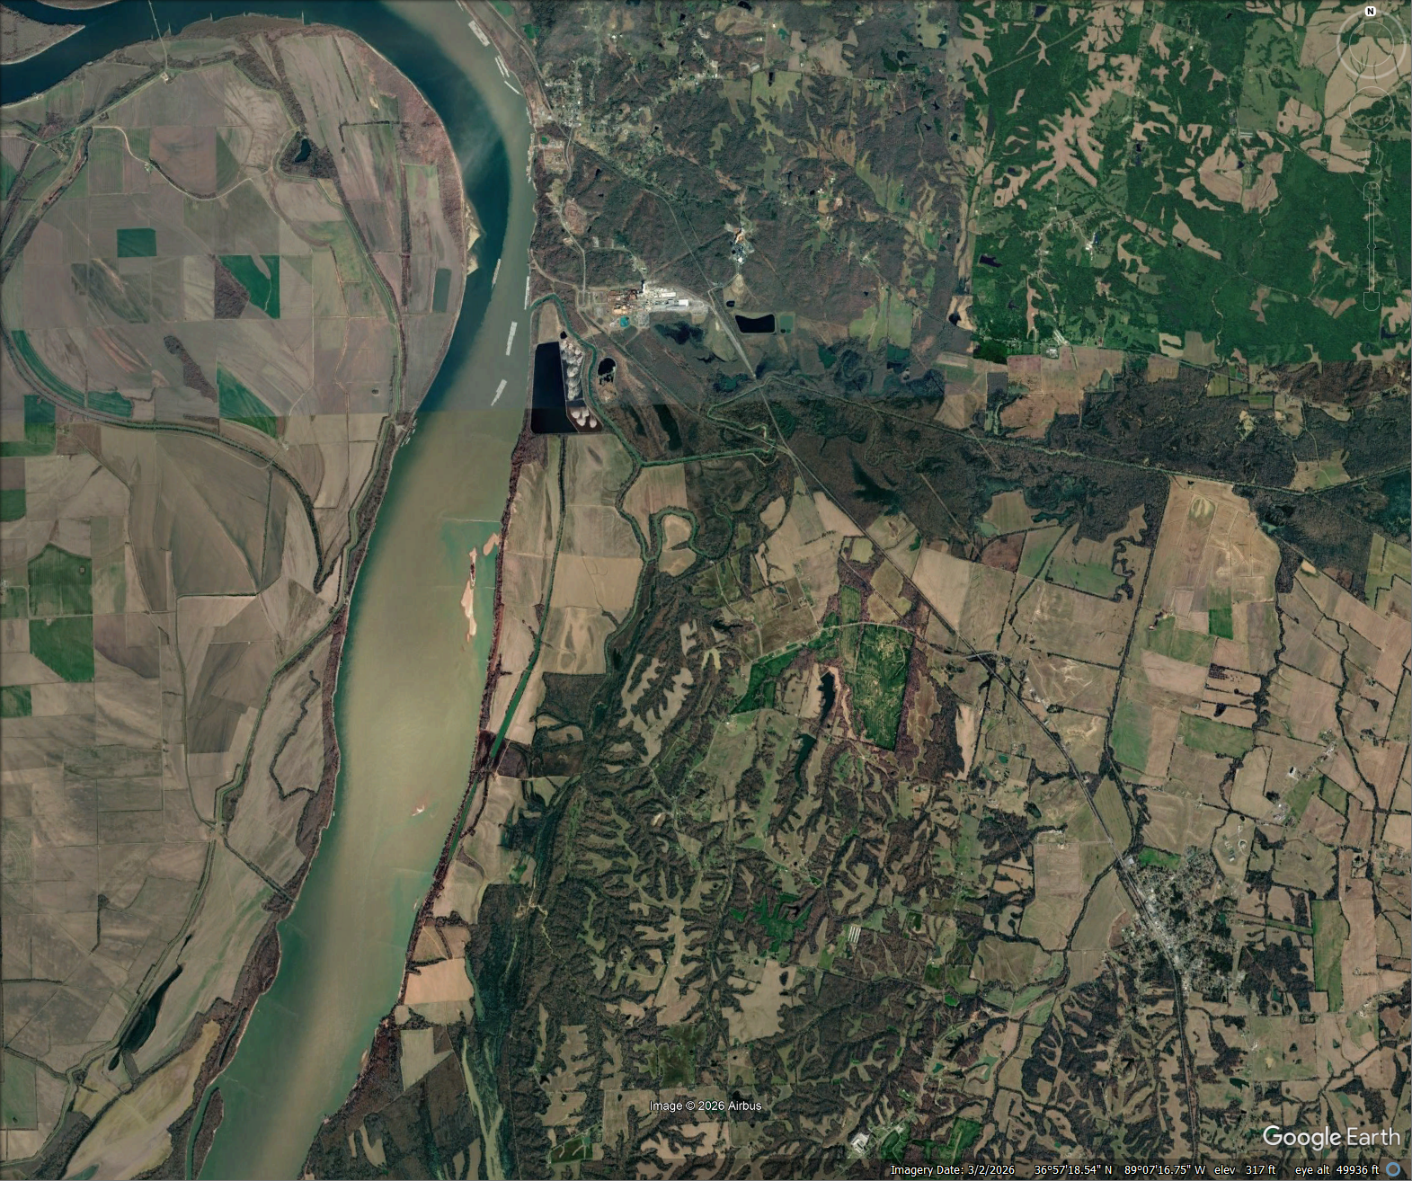

Slide 41



Slide 42
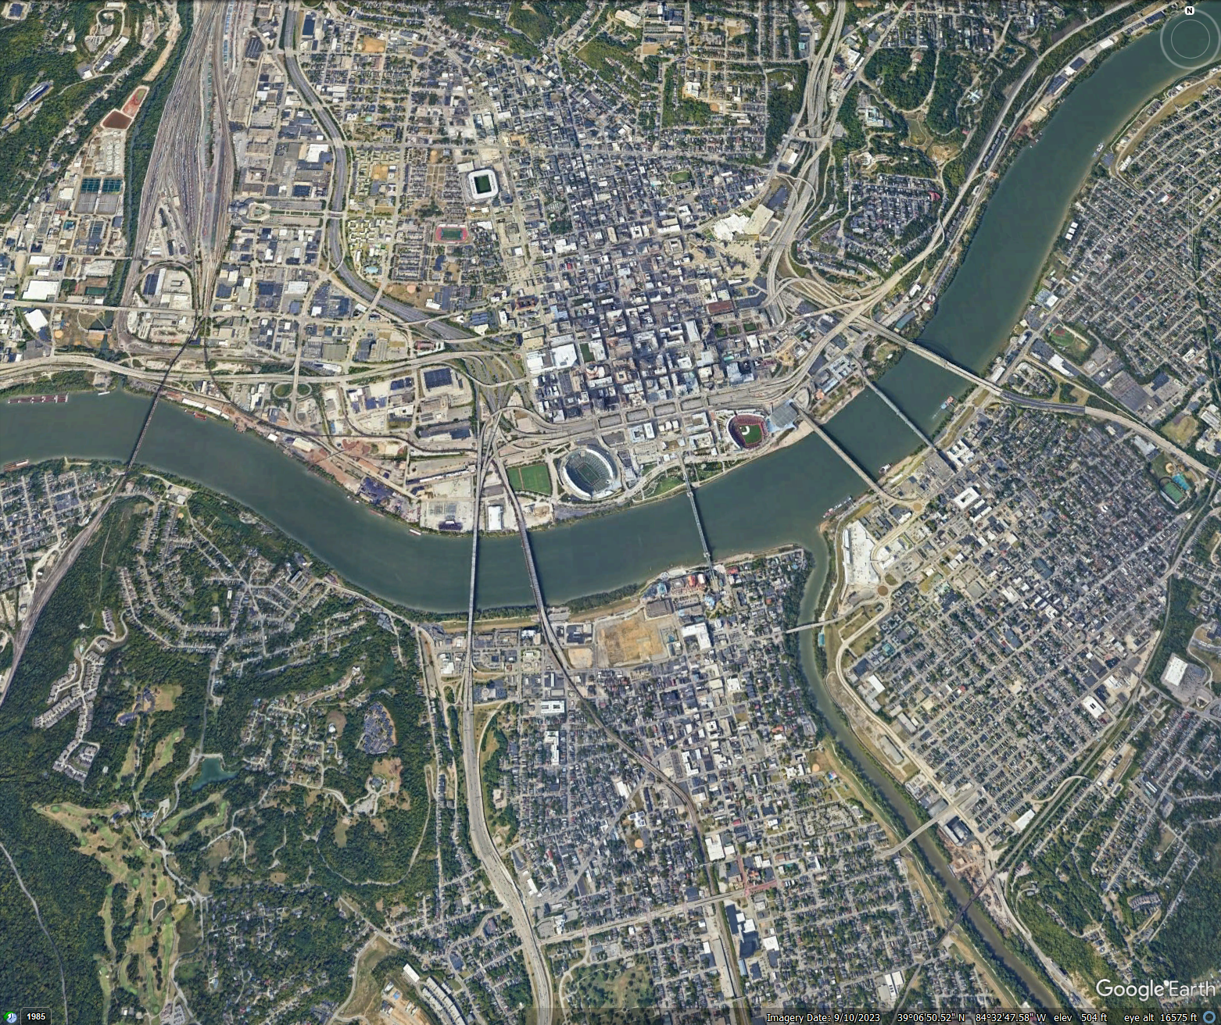

Slide 43



Slide 44

Ohio River Low Water Mark
1792

Slide 45
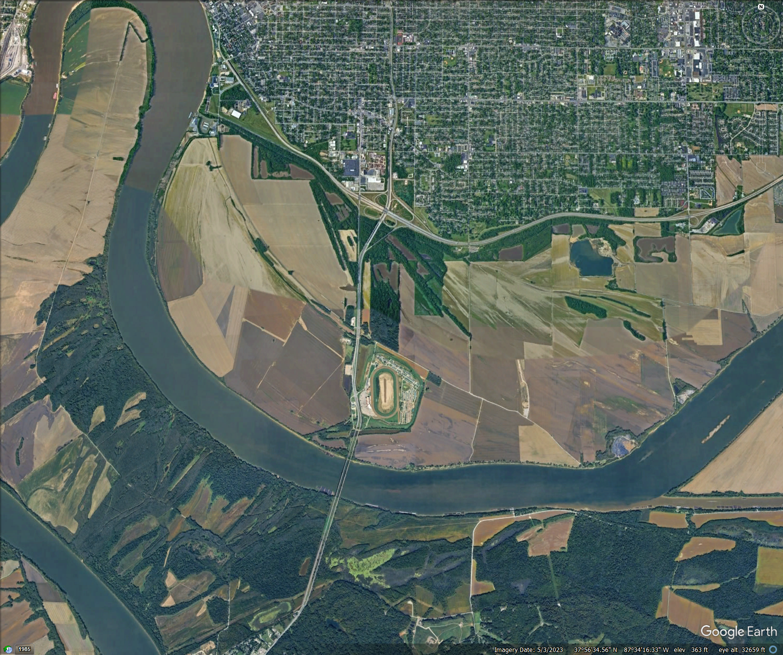

Slide 46
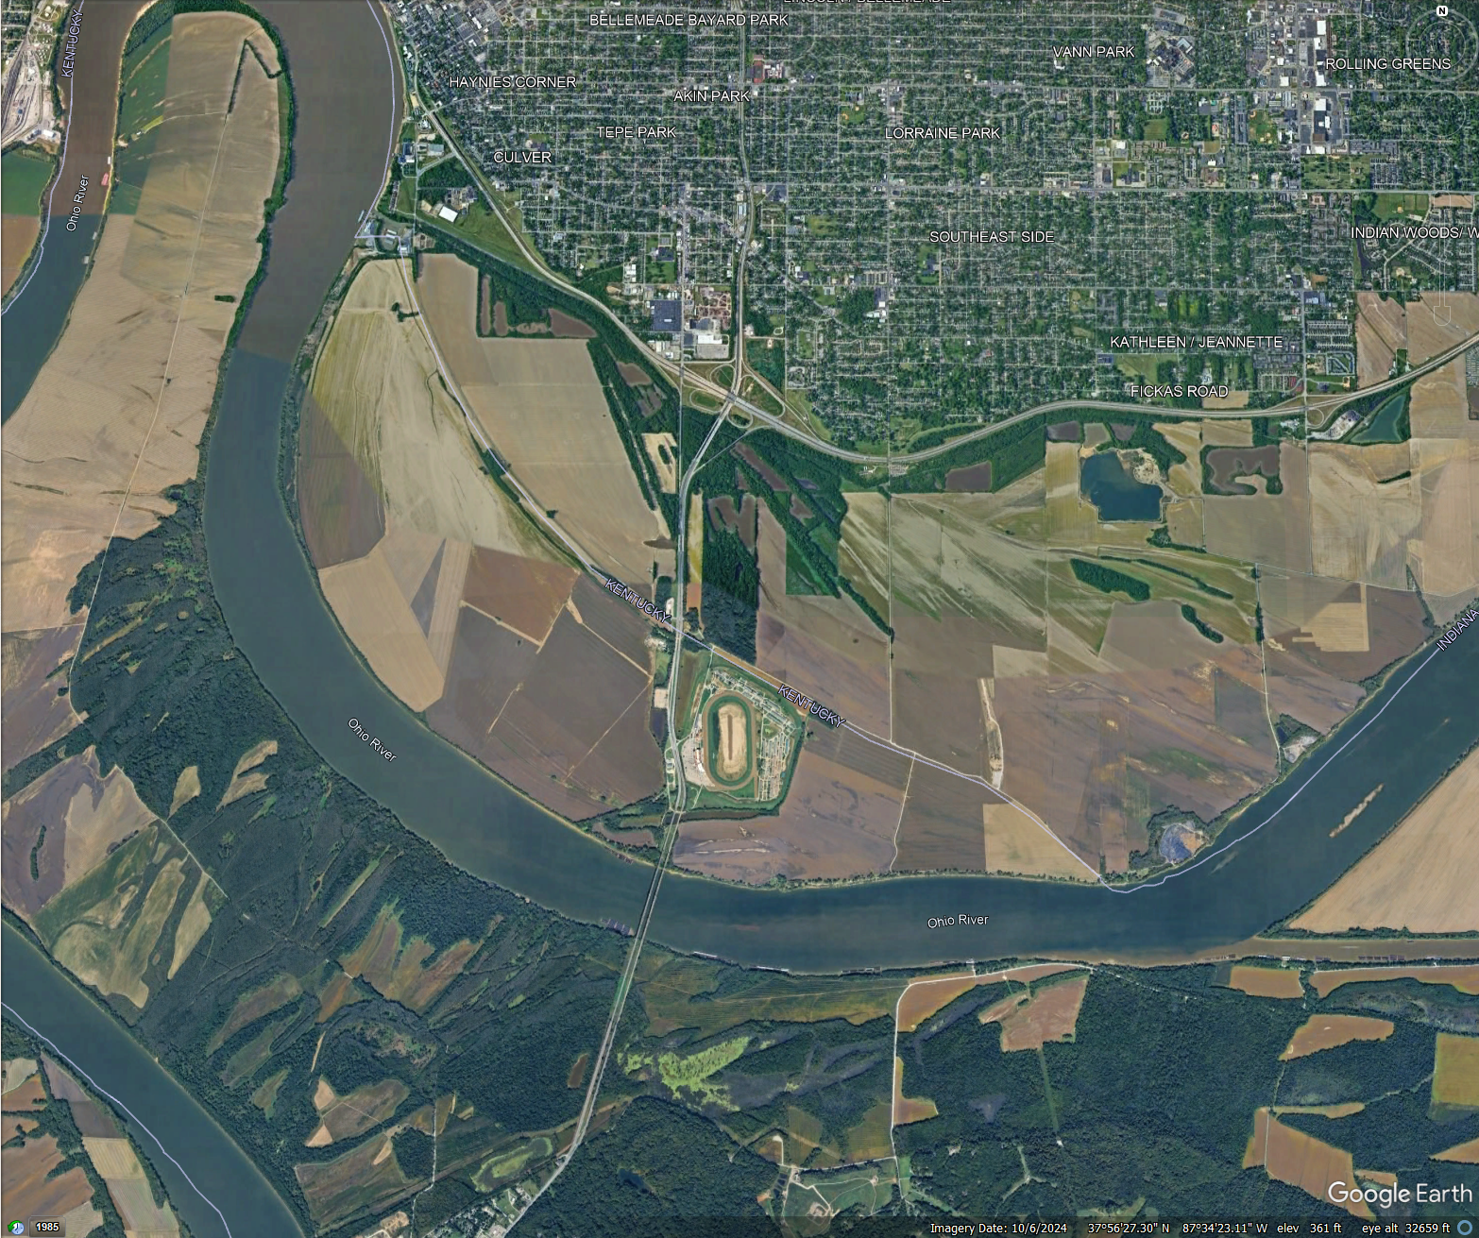


Slide 47

New Madrid Earthquake 1812

Slide 48

Outcome:
Audience Learns Intricacies of State Maritime Borders

Slide 49
Border Bridge Study

Slide 50
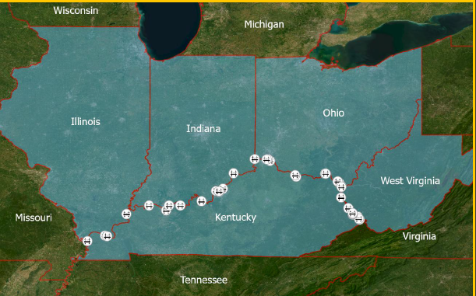

Slide 51
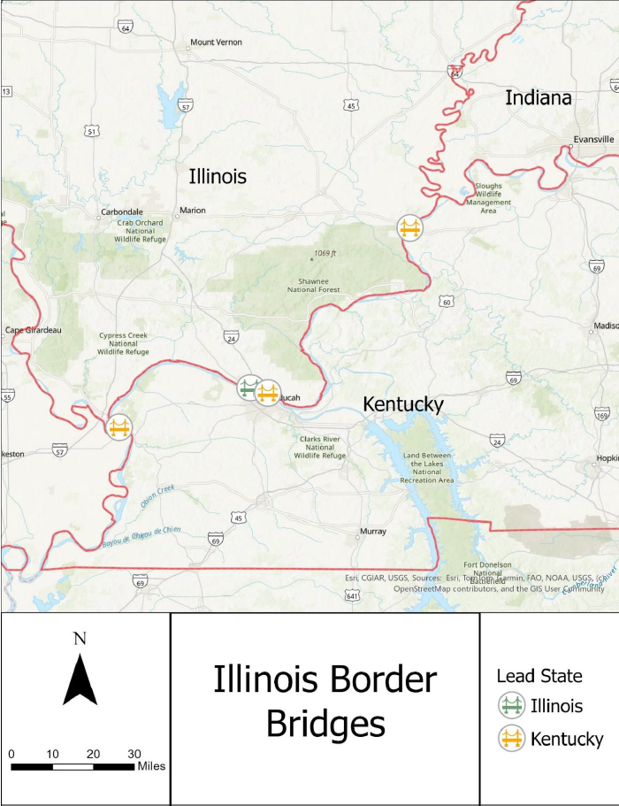

Slide 52
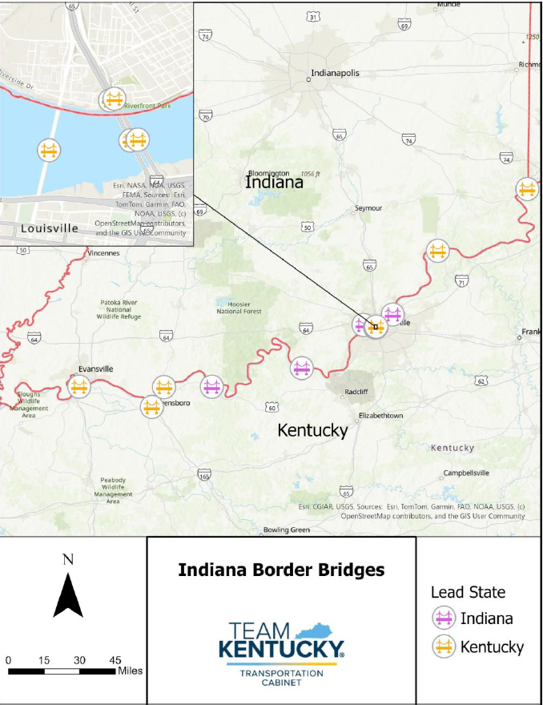

Slide 53
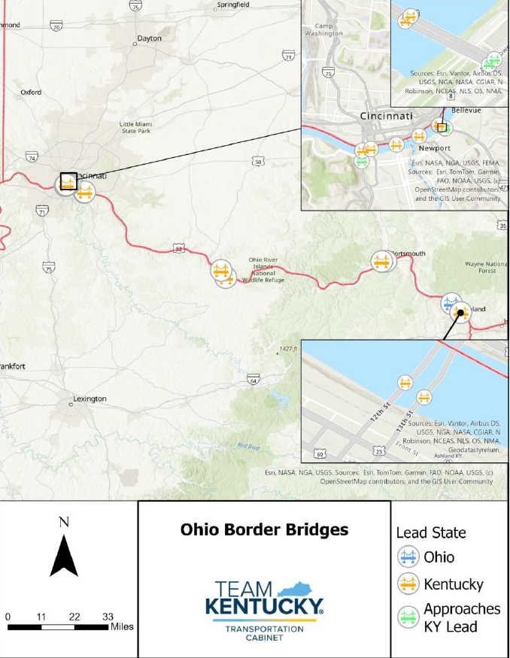

Slide 54
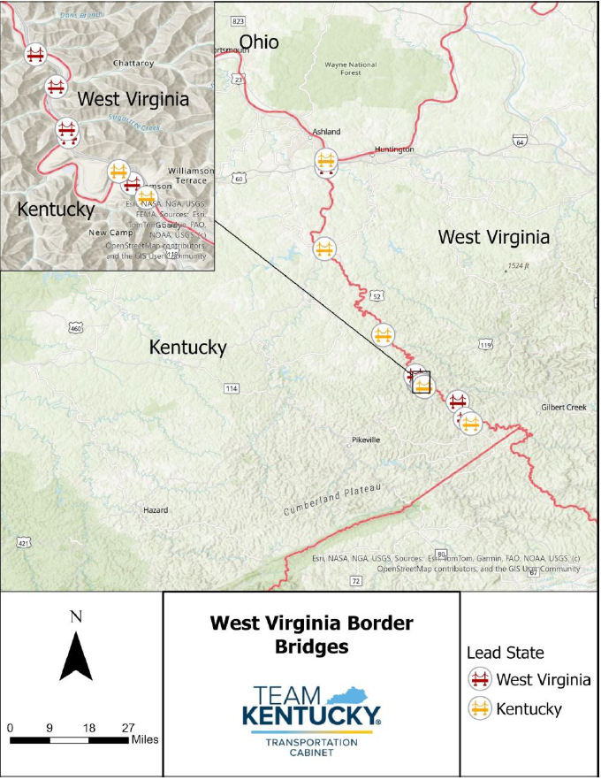

Slide 55
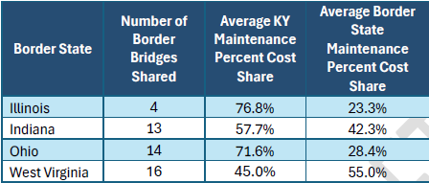
55 border bridges between Illinois, Indiana, Ohio, and West Virginia
Some 50/50, Some 100/0, Some ~75/25

Slide 56
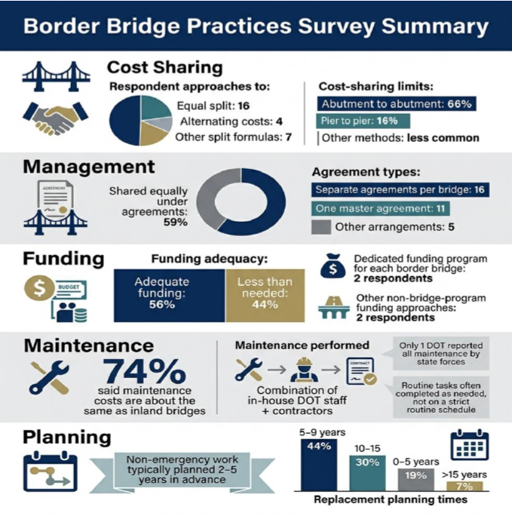

Slide 57
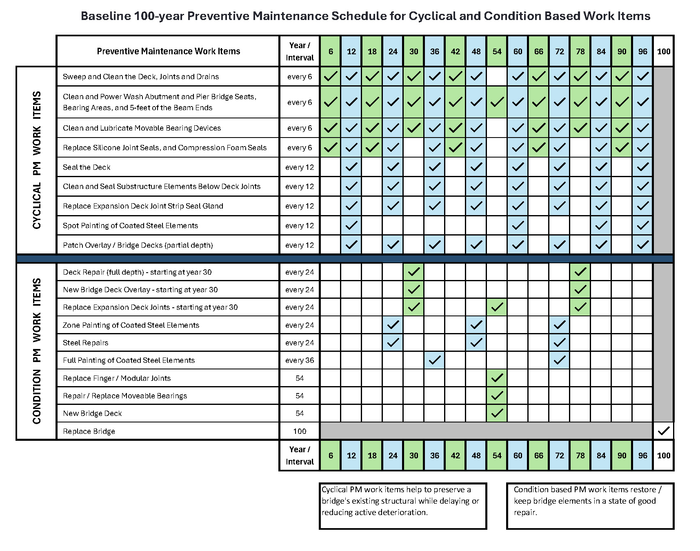

Slide 58
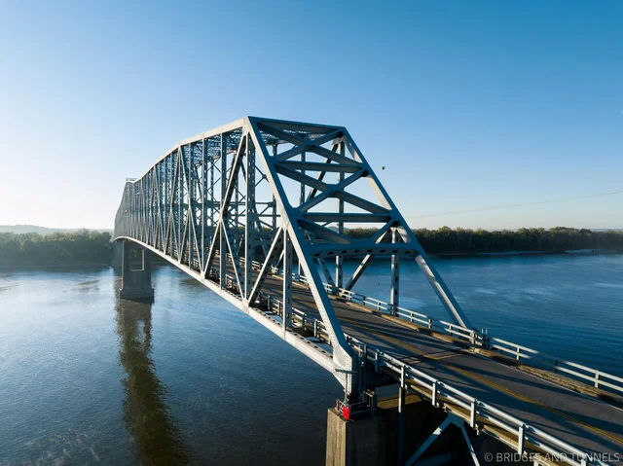
Outcomes
Analysis (costs, maintenance)
Replacement Plan
  Schedule
  Prioritization
  Cost Share
  Approach Cost Estimates
Preventative Maintenance Plan
  Review best practices
  Long- and short-term strategies and practices
  Funding strategies

Slide 59
Posted Bridges Study
(content by Copilot)

Slide 60
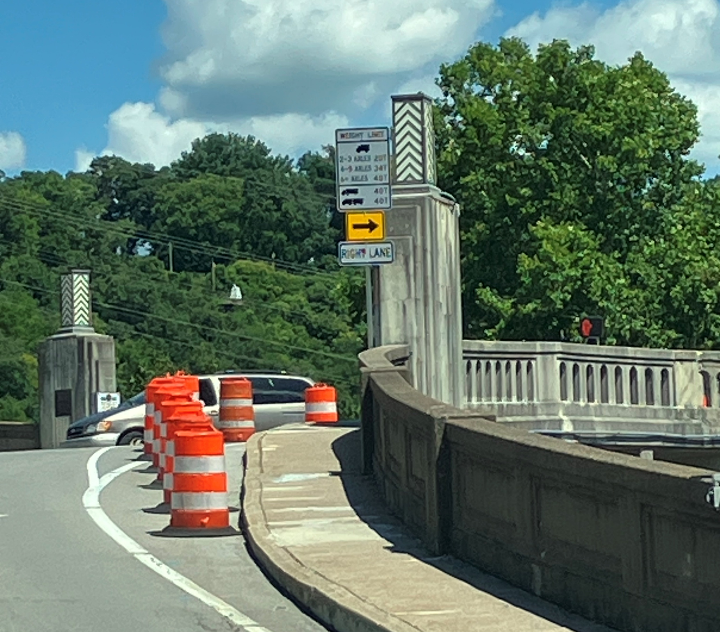
What we are doing
Developing a scalable, GIS‑based method to map posted bridges and identify advance sign locations.
Defining standard sign assemblies, language, and legends consistent with KYTC policy.
Selecting decision points that allow prohibited vehicles to detour/turn around before the limit zone.
Accounting for network topology and edge cases for reliable routing guidance.

Slide 61
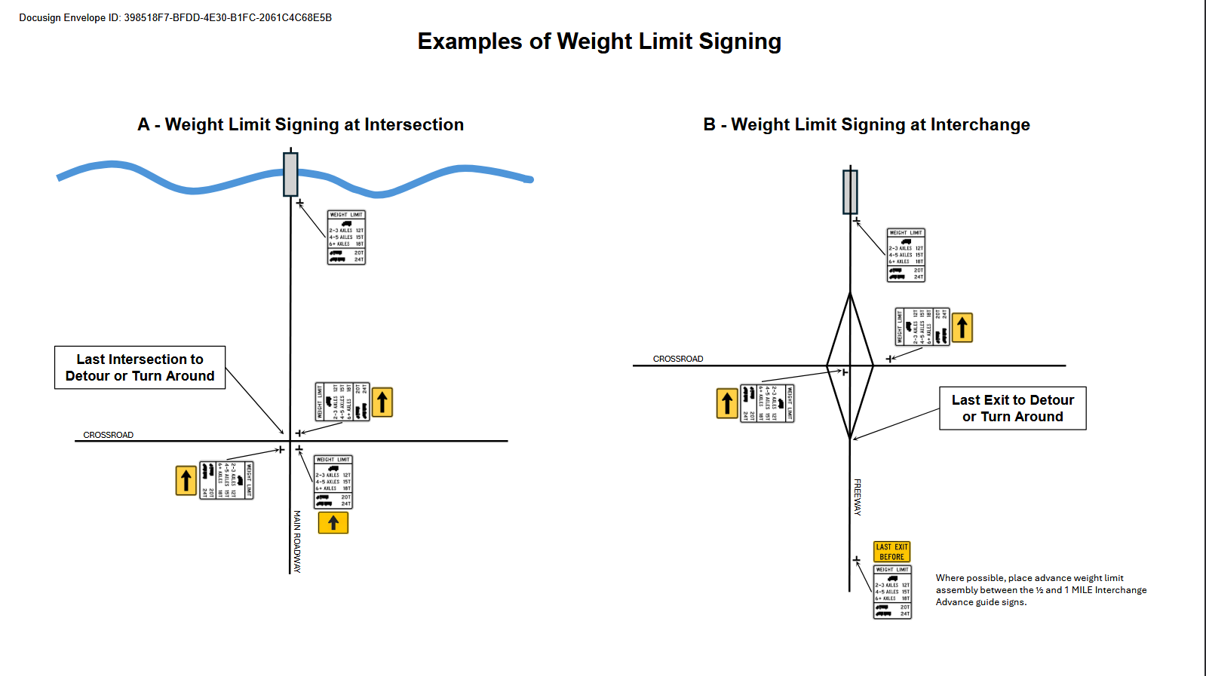
Why we are doing it
MUTCD 11th Edition requires advance weight‑limit signs so prohibited vehicles can avoid posted structures.
KYTC maintains ~2,300 weight‑posted bridges — consistent advance signage improves safety and operations.
Reduces heavy‑vehicle violations, turn‑around hazards, and improves network reliability for freight.

Slide 62
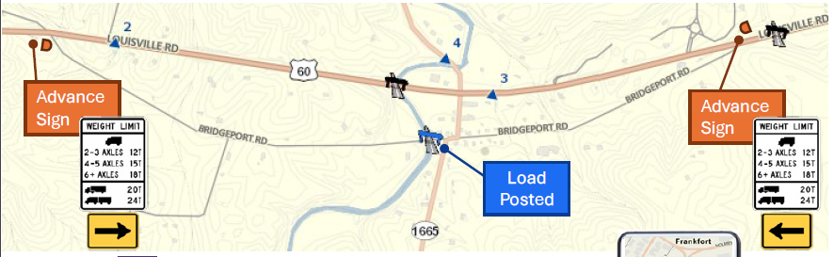
What the outcome will be
County‑level maps with recommended advance sign locations and standardized assemblies.
Clear language/legends and installation guidance usable by District Traffic Ops & Maintenance crews.
QA/QC checks for data and placement; process that Districts can repeat as posting data evolves.
Improved compliance and fewer last‑minute turn‑arounds near posted structures.

Slide 63
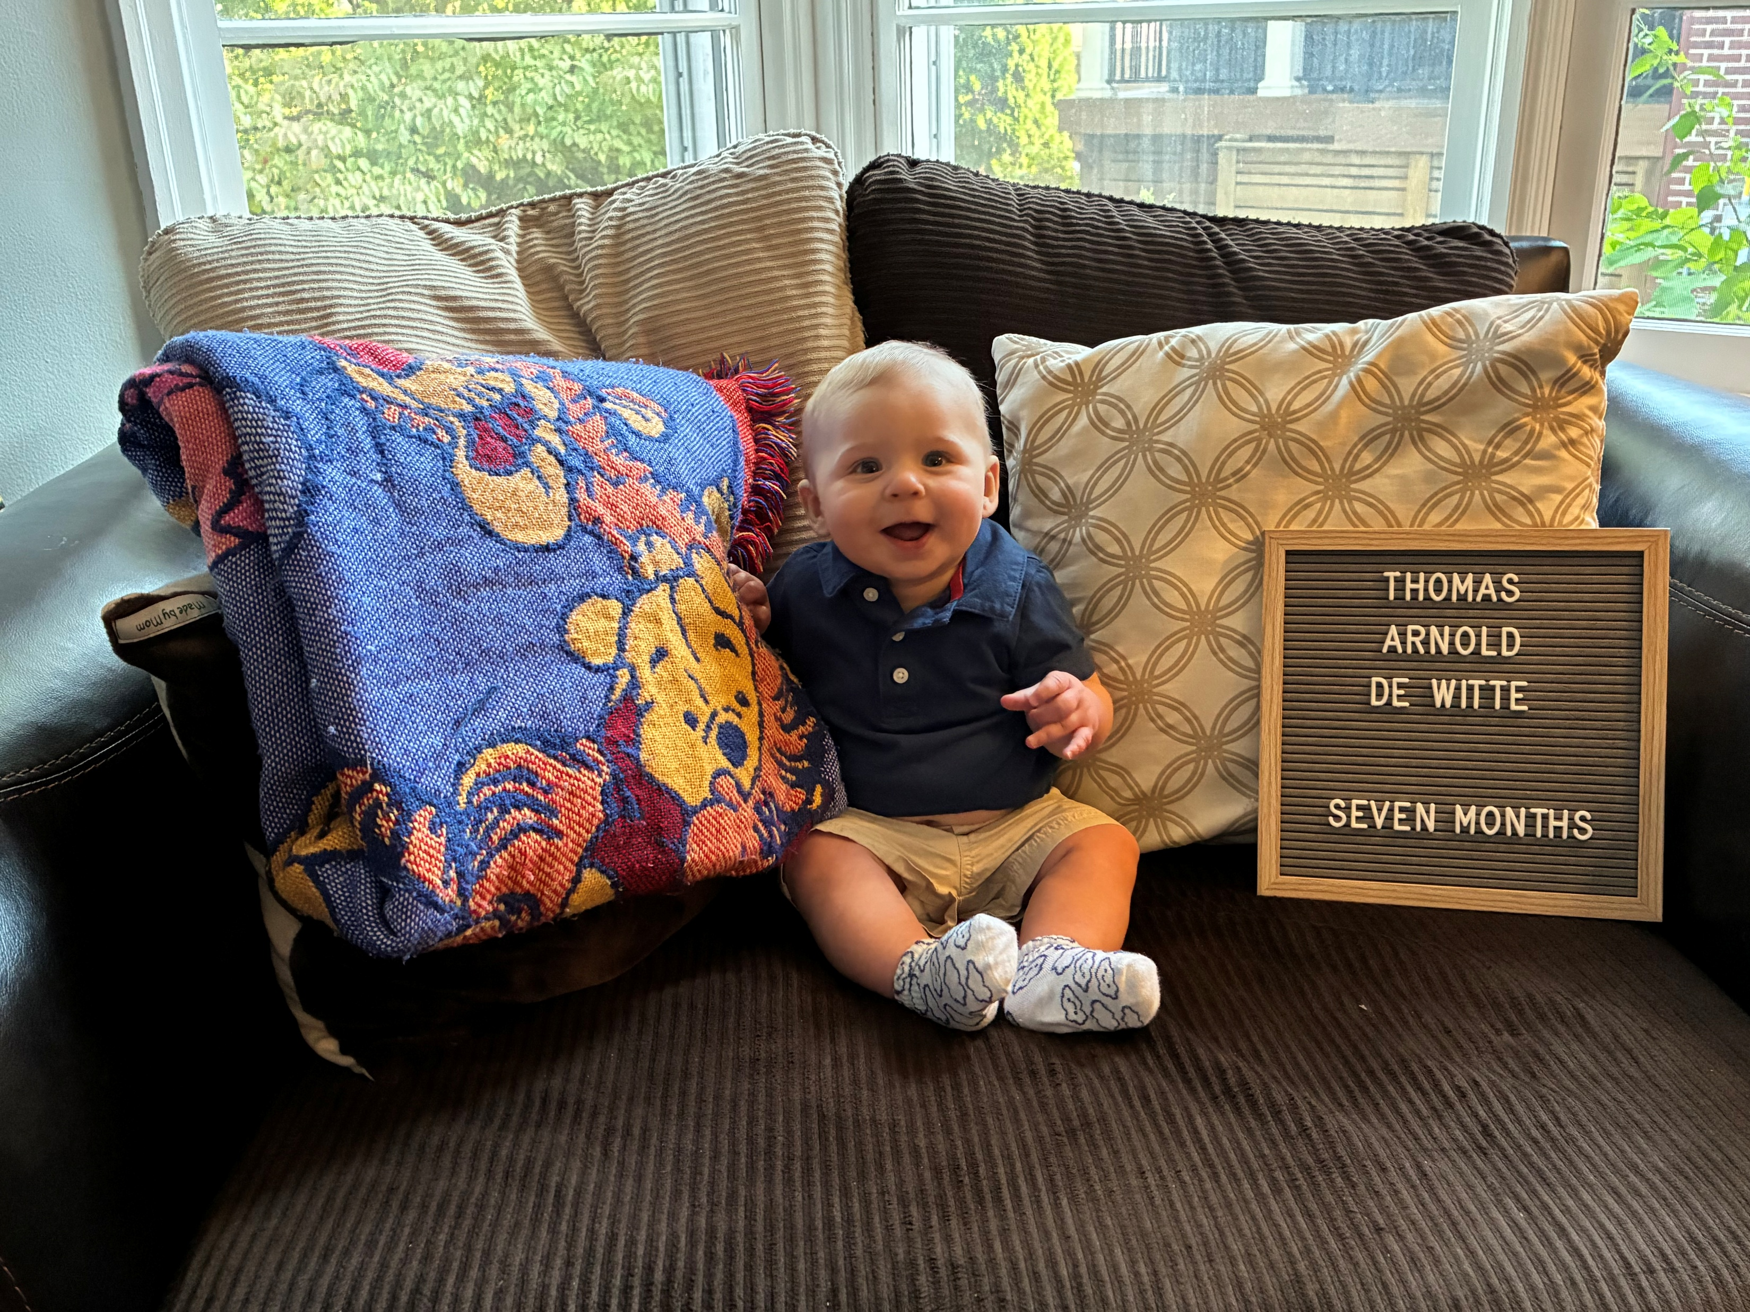

Exchange Tearful Goodbyes
Stephen De Witte, P.E.
Strategic Planning Branch Manager
Stephen.DeWitte@ky.gov
(502) 782-5056

